Slide 1
SySTemantics Final Project Presentation Sponsor Anthony Giorgio Poughkeepsie, NY February 2016
By
Siva Chintapalli
Dixita Sharegar
Bhargav Uppalapati

Slide 2
Introduction
A Metrics collector is a desktop application which runs on the Linux-based operating system.
The application incorporates CPU stats, memory stats, Network stats.
Helps users of the system to view the CPU throughput, network and memory stats allocated to the applications.

Slide 3
Work Done
Goal 1: Implemented the database.
Goal 2: Designed the User Interface.
Goal 3: Implemented (Connection to the database and logical Operations)
Goal 4: Refreshed data at the rate of 5 seconds on the UI.
Goal 4: Testing and maintenance of the project done.

Slide 4
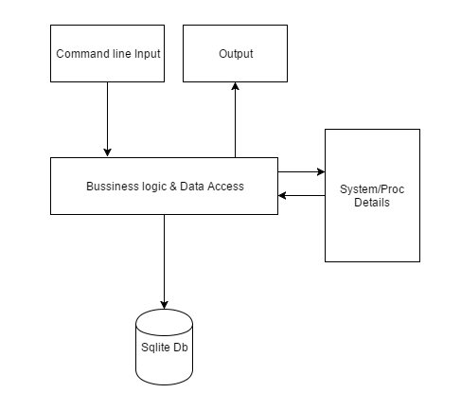
Architecture
User requests the application to view the running tasks/process in the system.
The operating system will control the application to provide the required information.
User can view network/memory/process statistics.

Slide 5
Software Flow
Initialization
Metrics Collection
Database Storage
UI data abstraction
Metrics presentation to user
Termination
The installer installs all software packages required for our application.
Metrics will be collected using different Linux commands.
The collected metrics will then be stored in the SQLite database.
Data is fetched from the database based on what the user is viewing. End User is not aware of the processes above this block.
All related metrics will be displayed to the user based on his screen selection.
The application is terminated followed by data collection and storage in database.

Slide 6
Development Standards
The project involves usage of agile methodology.
Feedback of end-user is taken at every phase and developed accordingly.
Java and SQL language were used in development of SySTemantics.
JavaFX was used for user interfaces and charts.
SySTematics will be open-source software which will be available to the public.

Slide 7
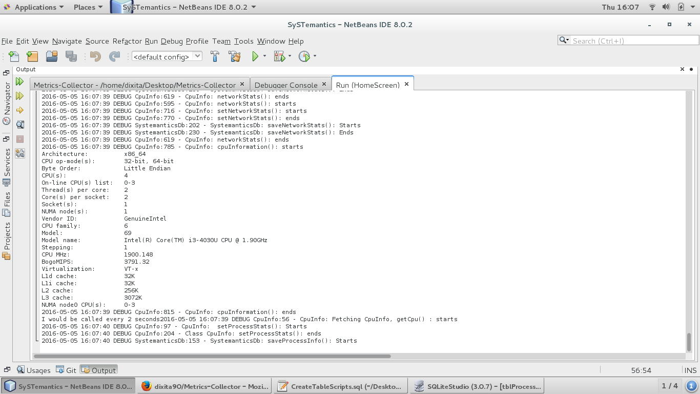
Error handling

Slide 8
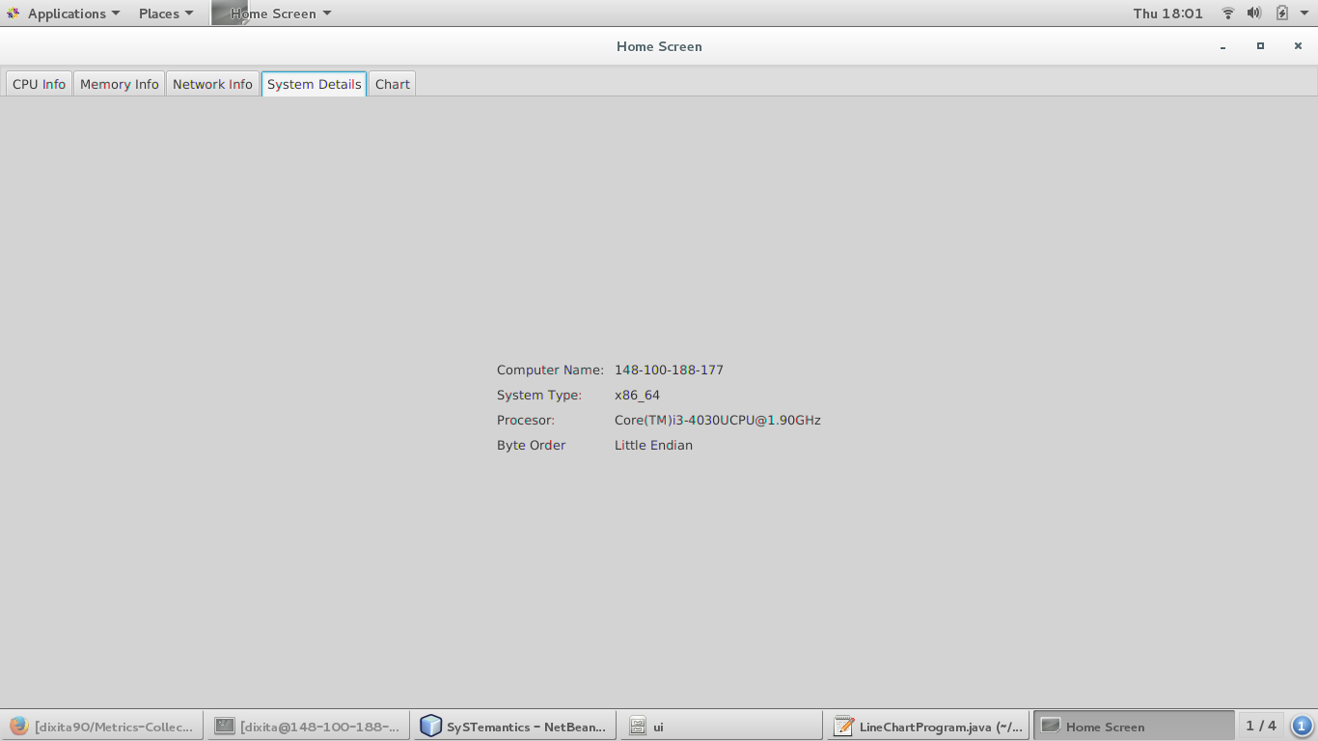
Screenshots

Slide 9
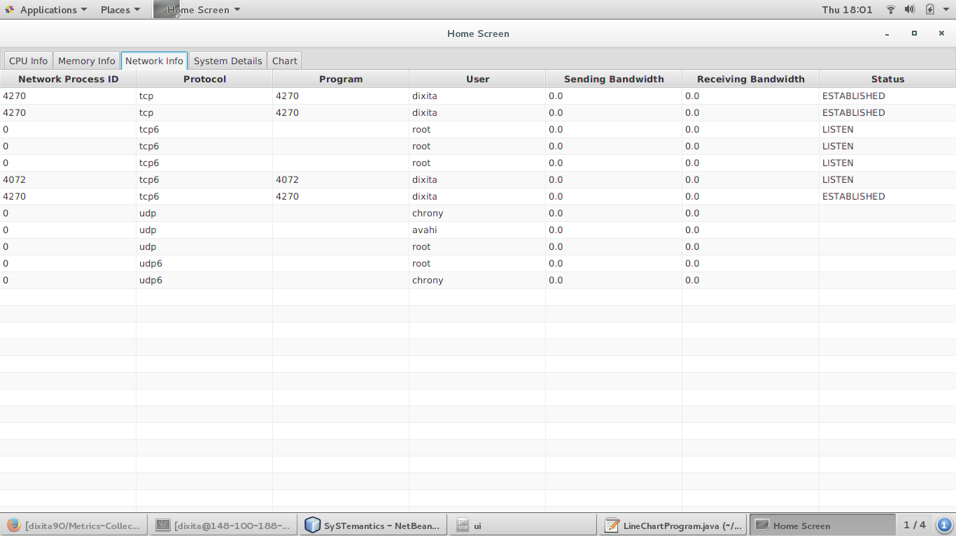

Slide 10
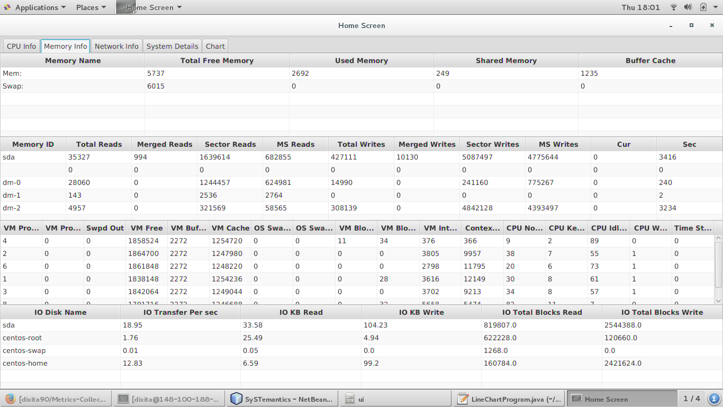

Slide 11
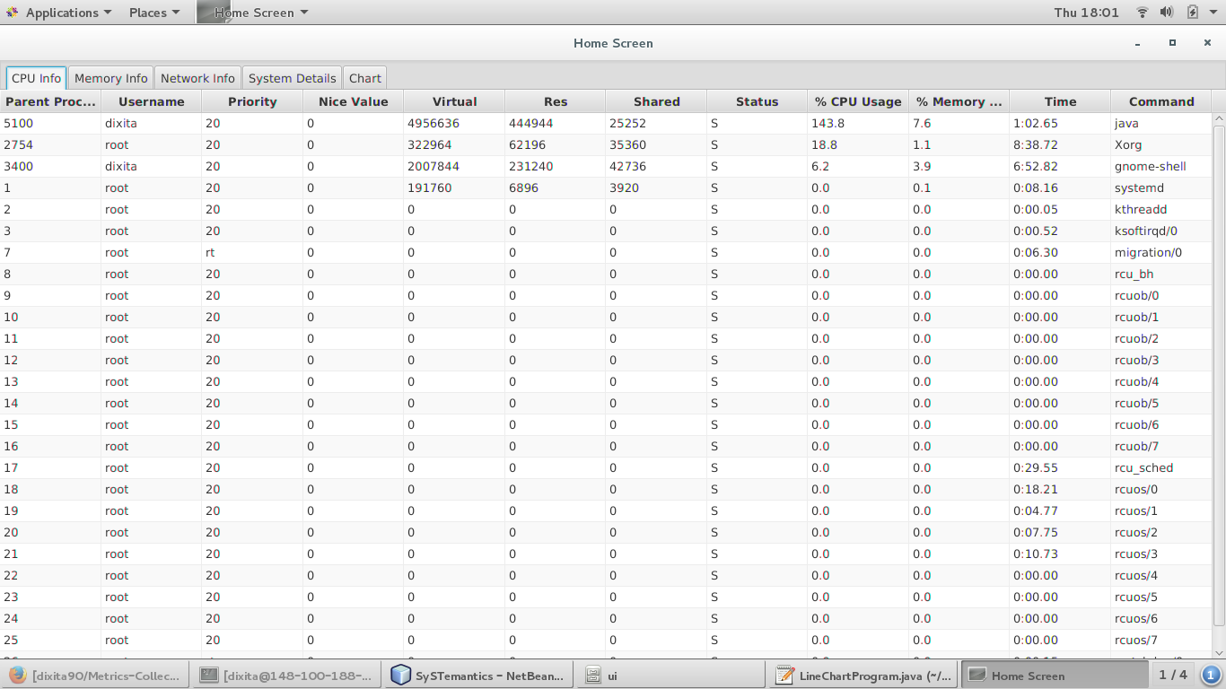

Slide 12
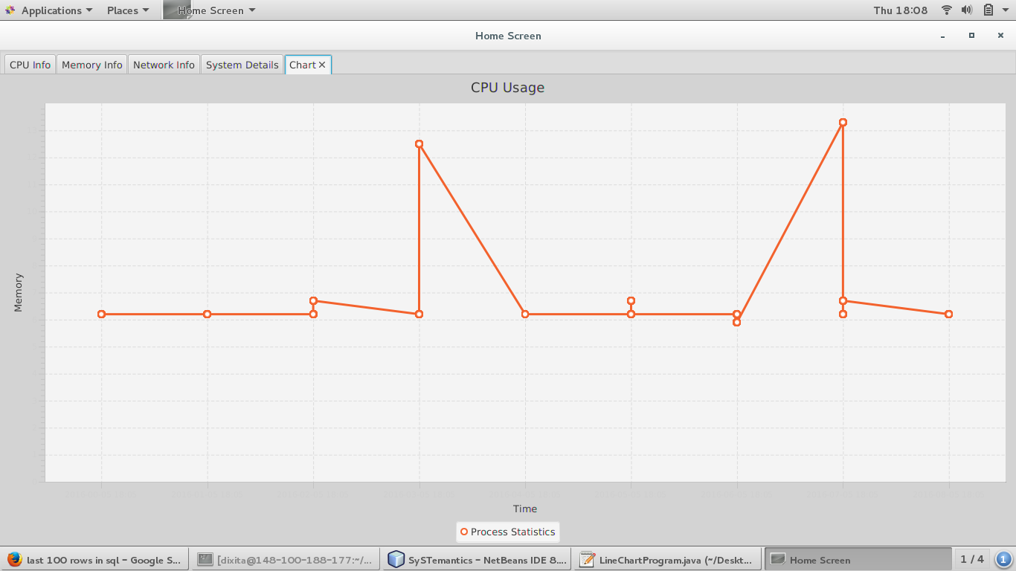

Slide 13
Future enhancements
More graphs can be added.
Due to time constraints, sufficient data analysis could not be performed
CSS styling could be done on UI, for a better user experience.

Slide 14
Difficulties and Lessons Learnt
It took a while to understand and integrate new technologies.
Integrating UI, business logic and database was a hurdle.

Slide 15
Demonstration time!!
Live execution of the resulting software application now demonstrated…

Slide 16
Questions/comments?
Thank You!!!!

